Slide 1

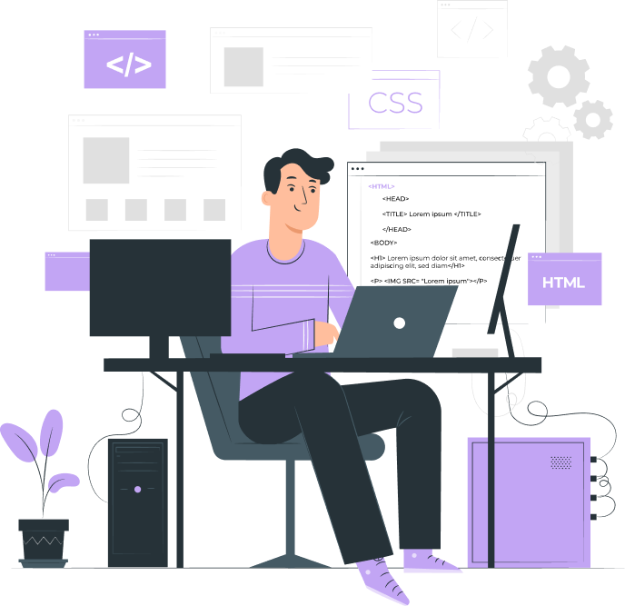
writing different queries for different screens

Slide 2

Topics
Typical Breakpoints
Writing media queries for different screens.

Slide 3
Typical Breakpoints
1) Extra small devices
2) Small devices
@media screen and (max-width: 576px) {
}
@media screen and (min-width: 576px) {
}
3) Medium devices
4) large devices
@media screen and (min-width: 768px){
}
@media screen and (min-width: 992px){
}
5) Extra large devices
@media screen and (min-width: 1200px){
}

Slide 4
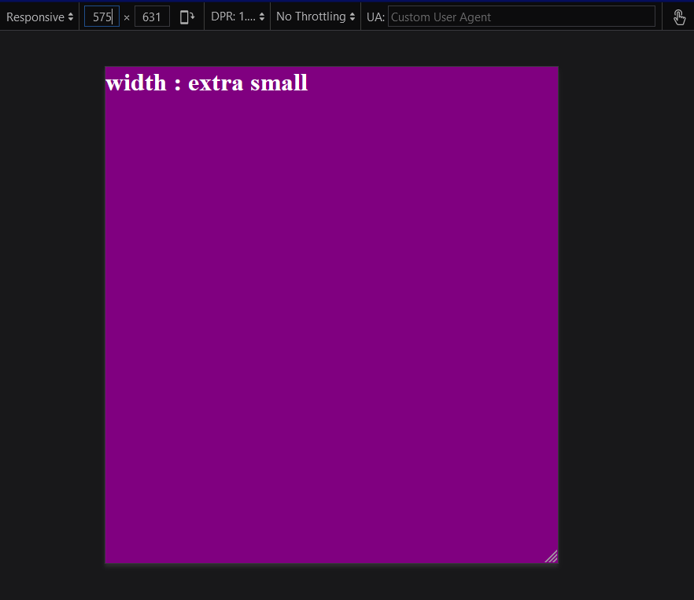
Writing media queries for different screens
Example for extra small device
style.css
// extra small
@media screen and (max-width: 576px) {
.box {
background-color: purple;
}
.screen::after {
content: " extra small";
}
}

Slide 5
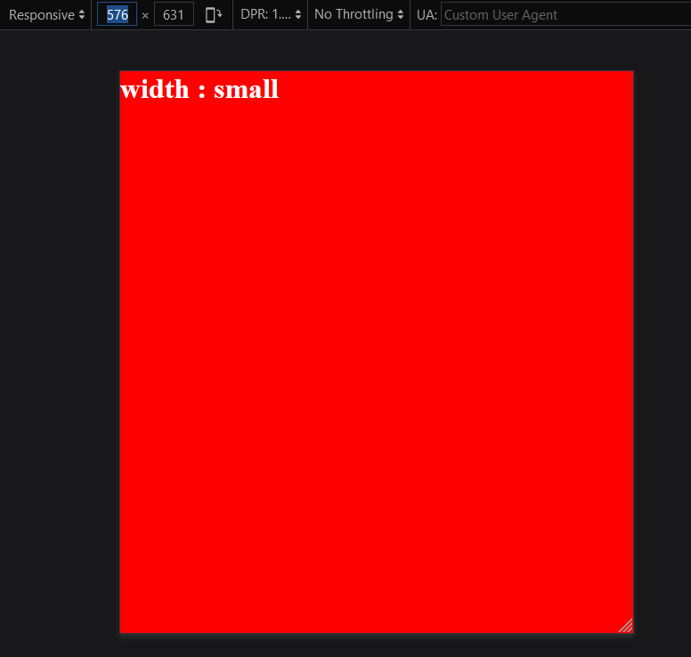
Example for small screen
style.css
// small
@media screen and (min-width: 576px) {
.box {
background-color: red;
}
.screen::after {
content: " small";
}
}

Slide 6
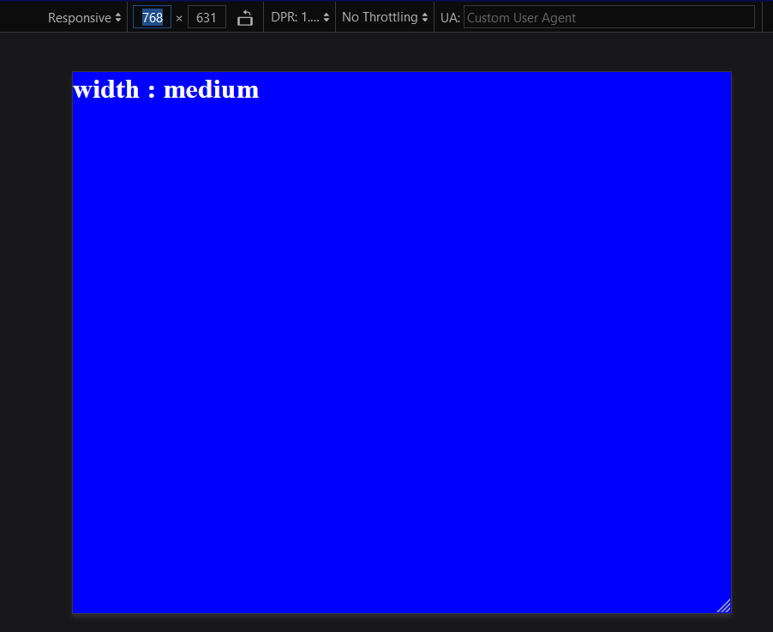
Example for large screen
style.css
// large
@media screen and (min-width: 992px) {
.box {
background-color: green;
}
.screen::after {
content: " large";
}
}

Slide 7
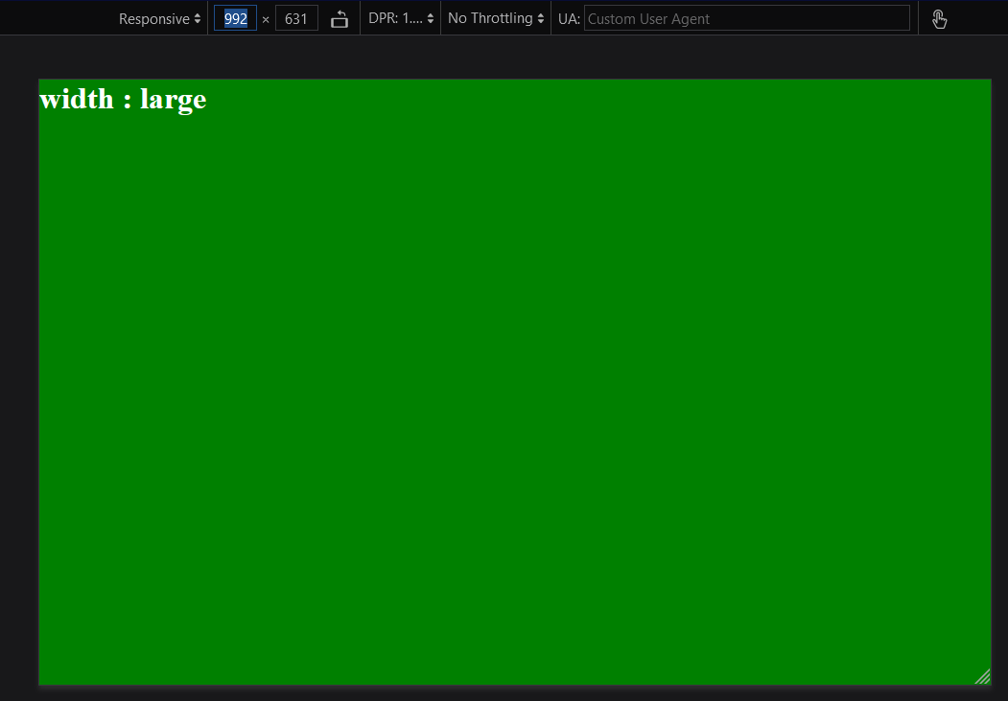
Example for large screen
style.css
// large
@media screen and (min-width: 992px) {
.box {
background-color: green;
}
.screen::after {
content: " large";
}
}

Slide 8
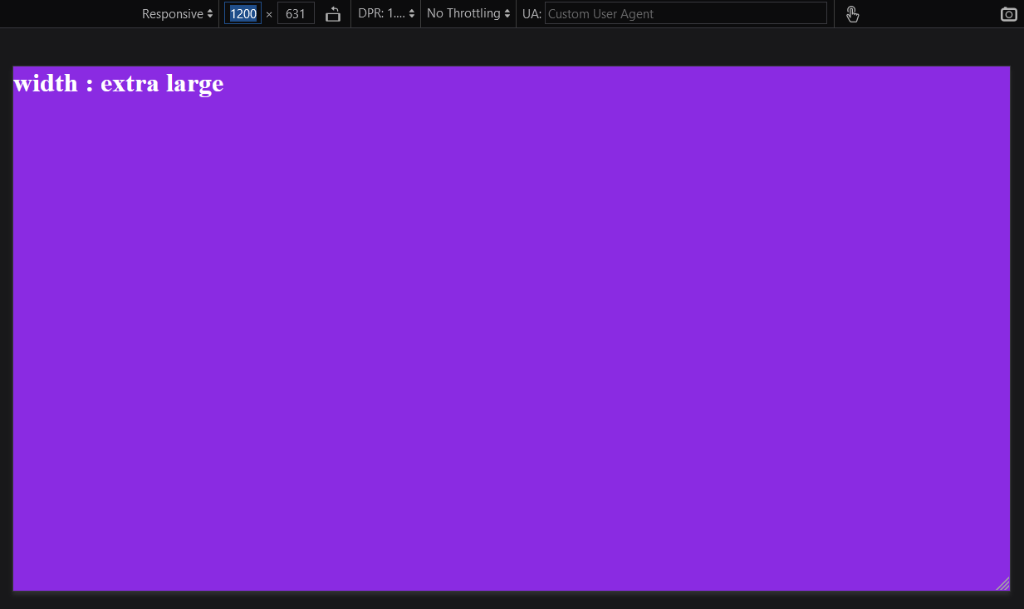
Example for extra large screen
style.css
// extra large
@media screen and (min-width: 1200px) {
.box {
background-color: blueviolet;
}
.screen::after {
content: " extra large";
}
}

Slide 9
THANK YOU

